Slide 1

SFL SCIENTIFIC Exercise

Slide 2
Table of Contents
Data Lakes
Serverless Architecture
ETL Pipeline
Modern MLOps

Slide 3
Data Lakes
A data lake is a centralized repository that allows you to store all your structured and unstructured data at any scale. You can store your data as-is, without having to first structure the data, and run different types of analytics—from dashboards and visualizations to big data processing, real-time analytics, and machine learning to guide better decisions.

Slide 4
Benefits
Organizations that have been in successful in generating value from their data, will outperform their peers by using Data Lakes. An AWS survey saw that organizations who implemented Data lakes outperformed similar companies by 9% in organic revenue growth. These leaders were able to do new types of analytics like machine learning over new sources like log files, data from click-streams, social media, and internet connected devices stored in the data lake. This helped them to identify, and act upon opportunities for business growth faster by attracting and retaining customers, boosting productivity, proactively maintaining devices, and making informed decisions.

Slide 5
Data Lakes VS Data Warehouse
As organizations with data warehouses see the benefits of data lakes, they are evolving their warehouse to include data lakes, and enable diverse query capabilities, data science use-cases, and advanced capabilities for discovering new information models.
Characteristics | Data Warehouse | Data Lake
Data | Relational from transactional systems, operational databases, and line of business applications | Non-relational and relational from IoT devices, web sites, mobile apps, social media, and corporate applications
Schema | Designed prior to the DW implementation (schema-on-write) | Written at the time of analysis (schema-on-read)
Price/Performance | Fastest query results using higher cost storage | Query results getting faster using low-cost storage
Data Quality | Highly curated data that serves as the central version of the truth | Any data that may or may not be curated (ie. raw data)
Users | Business analysts | Data scientists, Data developers, and Business analysts (using curated data)
Analytics | Batch reporting, BI and visualizations | Machine Learning, Predictive analytics, data discovery and profiling
Gartner names this evolution the “Data Management Solution for Analytics” or “DMSA.”

Slide 6

How Will it benefit you?
Data movement
Data Lakes allow you to import any amount of data that can come in real-time. Data is collected from multiple sources and moved into the data lake in its original format. This process allows you to scale to data of any size, while saving time of defining data structures, schema, and transformations.
Securely store, and catalog data
Data Lakes allow you to store relational data like operational databases and data from line of business applications, and non-relational data like mobile apps, IoT devices, and social media. They also give you the ability to understand what data is in the lake through crawling, cataloging, and indexing of data. Finally, data must be secured to ensure your data assets are protected.
Analytics
Data Lakes allow various roles in your organization like data scientists, data developers, and business analysts to access data with their choice of analytic tools and frameworks. This includes open-source frameworks such as Apache Hadoop, Presto, and Apache Spark, and commercial offerings from data warehouse and business intelligence vendors. Data Lakes allow you to run analytics without the need to move your data to a separate analytics system.
Machine Learning
Data Lakes will allow organizations to generate different types of insights including reporting on historical data and doing machine learning where models are built to forecast likely outcomes and suggest a range of prescribed actions to achieve the optimal result.

Slide 7

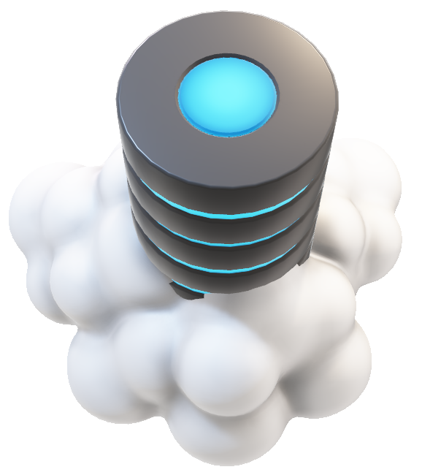
Serverless Architecture
Serverless architecture is an approach to software design that allows developers to build and run services without having to manage the underlying infrastructure. Developers can write and deploy code, while a cloud provider provisions servers to run their applications, databases, and storage systems at any scale. You no longer have to provision, scale, and maintain servers to run your applications, databases, and storage systems.
By using a serverless architecture, your developers can focus on their core product instead of worrying about managing and operating servers or runtimes, either in the cloud or on-premises. This reduced overhead lets developers reclaim time and energy that can be spent on developing great products which scale and that are reliable.

Slide 8

Let's see how the pros outweigh the cons for going serverless.

Slide 9
Pros
Cost
Cloud providers charge you on a per-invocation basis, so you’re not paying for unused servers or virtual machines.
Scalability
Function instances are automatically created or removed in response to traffic variations, within the boundaries of concurrency limits.
Productivity
Engineers who use serverless can simply deploy their code without having to manage any servers, which helps accelerate delivery cycles and rapidly scale company operations.
Cons
It is said to be more challenging to debug serverless code.
They work seamlessly with loosely coupled systems, might not work very efficiently with High performance networks.

Slide 10
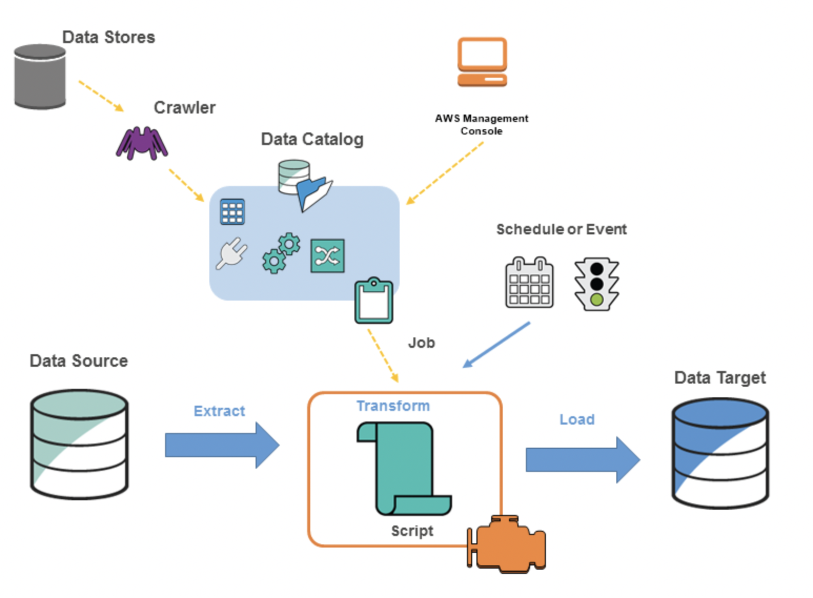
ETL Pipeline
It is persistent metadata store in AWS Glue. It contains table definitions, job definitions, and other control information to manage your AWS Glue environment.
On the following slides we can see a simple overview ETL graphical demonstration of exercise performed in section 1.
Here, the data source would be the CSV/Excel files that can be stored on your local machine, S3 etc.
The AWS serverless ETL we would use is AWS GLUE. It is a fully managed Extract, Transform and Load service, which is simple and cost effective to categorize, clean, enrich and move your data to a target.
We would use Python Language to transform the data via Pandas.
A crawler accesses your data store, extracts metadata, and creates table definitions in the AWS Glue Data Catalog.
AWS GLUE Data Catalog
Data Target can be any Database for our exercise lets assume it is an SQL DB.

Slide 11
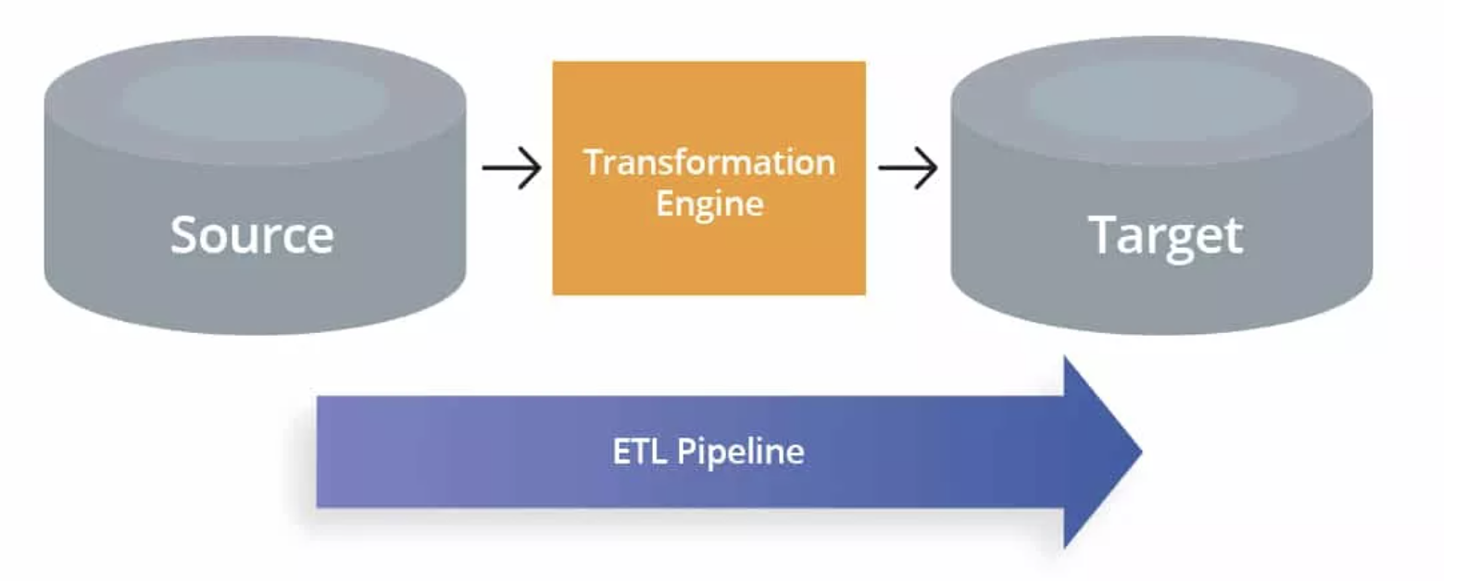
Process Design
We can define jobs in AWS Glue to accomplish the work that's required to extract, transform, and load (ETL) data from a data source to a data target. We typically perform the following actions:
For data store sources, you define a crawler to populate your AWS Glue Data Catalog with metadata table definitions. You point your crawler at a data store, and the crawler creates table definitions in the Data Catalog.
AWS Glue can generate a script to transform your data, or you can provide the script in the AWS Glue console or API.
You can run your job on demand, or you can set it up to start when a specified trigger occurs. The trigger can be a time-based schedule or an event.

Slide 12
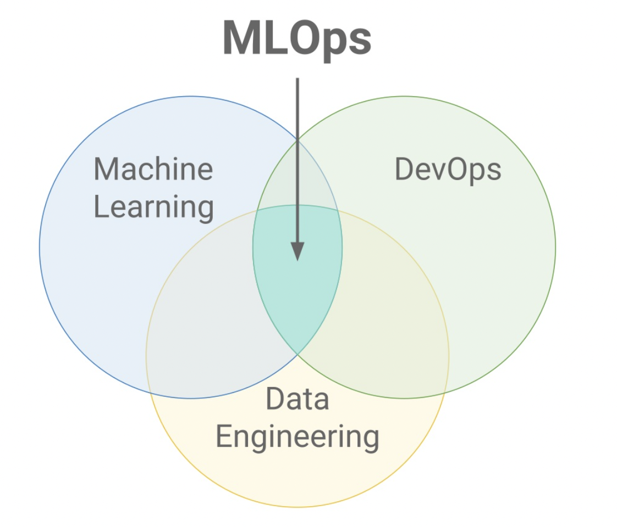
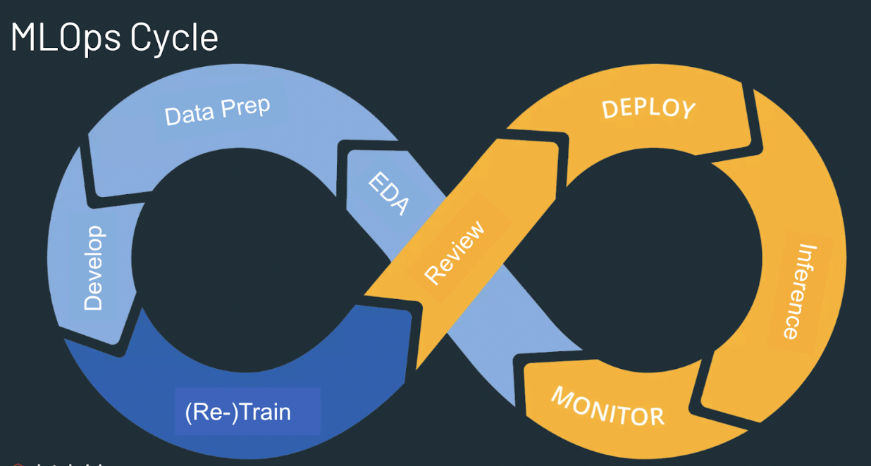
Ml-ops
MLOps or ML Ops is a set of practices that aims to deploy and maintain machine learning models in production reliably and efficiently. The term is a compound of machine learning and the continuous development practice of DevOps.

Slide 13
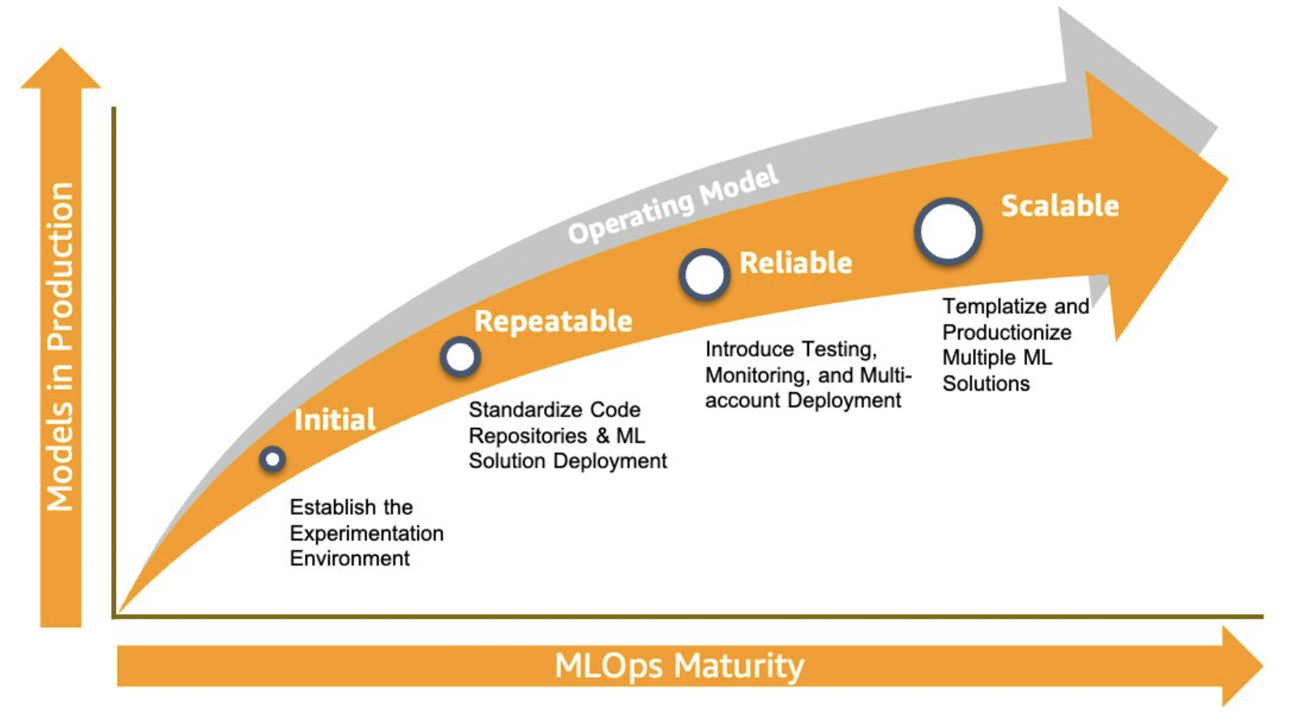
Ml-ops roadmap
As enterprise businesses embrace machine learning (ML) across their organizations, manual workflows for building, training, and deploying ML models tend to become bottlenecks to innovation. To overcome this, I would recommend using cloud ML-OPS services such as AWS SAGE MAKER.
Building an MLOps foundation that can cover the operations, people, and technology needs of enterprise customers is challenging. Therefore, we define the following maturity model that defines the necessary capabilities of MLOps in four key phases.

Slide 14

Thank you

